Slide 1
InsurAI Milestone 3
End to End Execution Flow of Backend Architecture
Presented by – Anushka Dutta

Slide 2
High-Level System Architecture
Frontend (Client Side): Developed using React.js, handling user interactions and routing via React Router.
Backend (Server Side): Built with Spring Boot, following a layered architecture (Controller, Service, Repository).
Communication: RESTful API calls using JSON for data exchange.
Database: Persistent storage via Spring Data JPA (Java Persistence API).

Slide 3
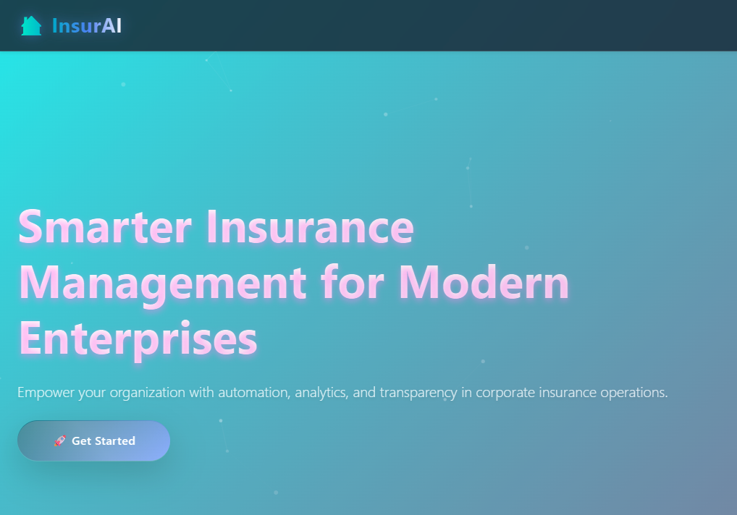
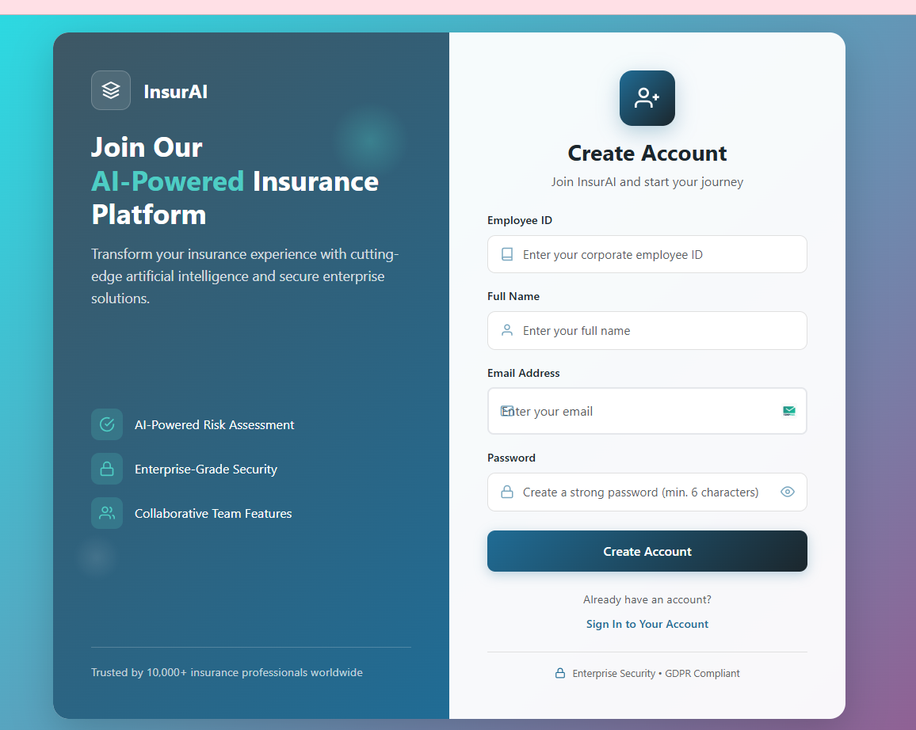
The Execution Flow: Phase 1 (Frontend Action)
User Trigger: The user clicks the "Get Started" button on the Homepage.
Client-Side Routing: React Router intercepts the click and navigates the user to the /employee/register route.
Data Capture: The user fills out the registration form; the data is stored in the React component's state.
API Dispatch: Upon form submission, an HTTP POST request is sent to the backend endpoint (e.g., /api/employees/register).
3
1
2
HTTP POST to backend server
/employee/register route

Slide 4
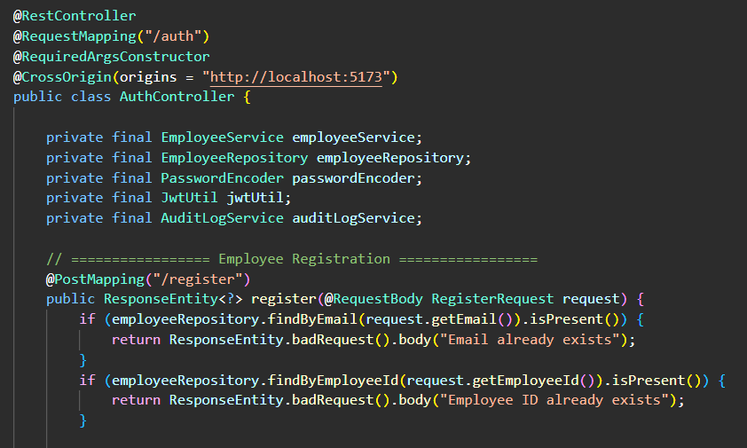
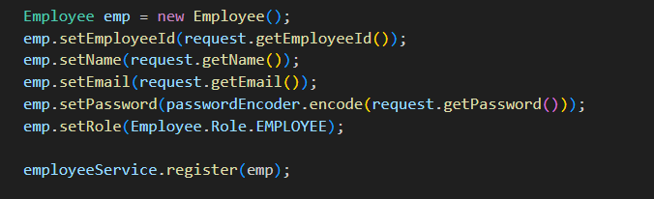
The Execution Flow: Phase 2 (Backend Controller)
Now at backend when we are executing the spring boot already the inbuild backend server of Spring boot – Tomcat get started . Hence the HTTP post request from frontend(react) is handled by the Tomcat Server and is first redirected to the controller(which serves as the entry point for all incoming web requests from your React frontend) .
Entry Point: The request hits the AuthController in the Spring Boot application.
Annotation Handling: The @PostMapping annotation identifies the correct method to handle the registration.
Request Body Mapping: The incoming JSON data is automatically mapped to a Data Transfer Object (DTO) or Entity class.
Initial Validation: The controller performs basic checks to ensure the required fields (name, email, etc.) are present.
5
4
6
And Employee is the entity which is mapped to the database in service layer
Here request is the DTO

Slide 5
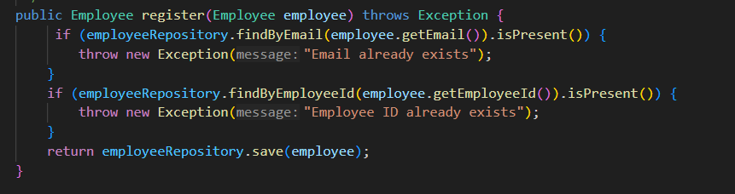
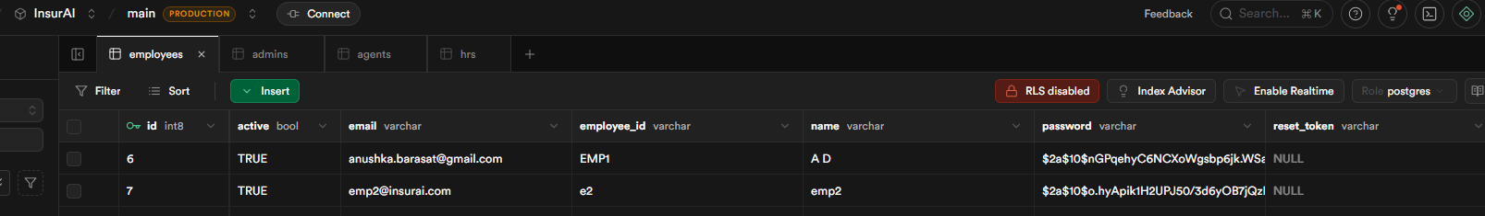
The Execution Flow: Phase 3 (Business Logic Layer)
Service Invocation: The Controller calls the EmployeeService to process the request.
Logic Application: The service checks if the email is already registered to prevent duplicate entries.
Entity Mapping: The DTO is converted into a JPA Entity ready for database insertion.
Repository Call: The Service invokes the EmployeeRepository interface.
Spring Data JPA: The repository uses the .save() method to interact with the underlying SQL database and finally the employee is saved in the superbase database.
Transaction Management: Spring manages the database transaction, ensuring the data is successfully committed or rolled back if an error occurs.
.
7
EmployeeService layer
8
A snapshot of how employees are now stored after registration in database

Slide 6
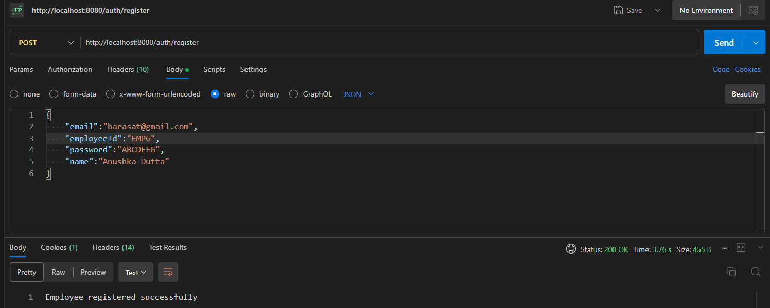
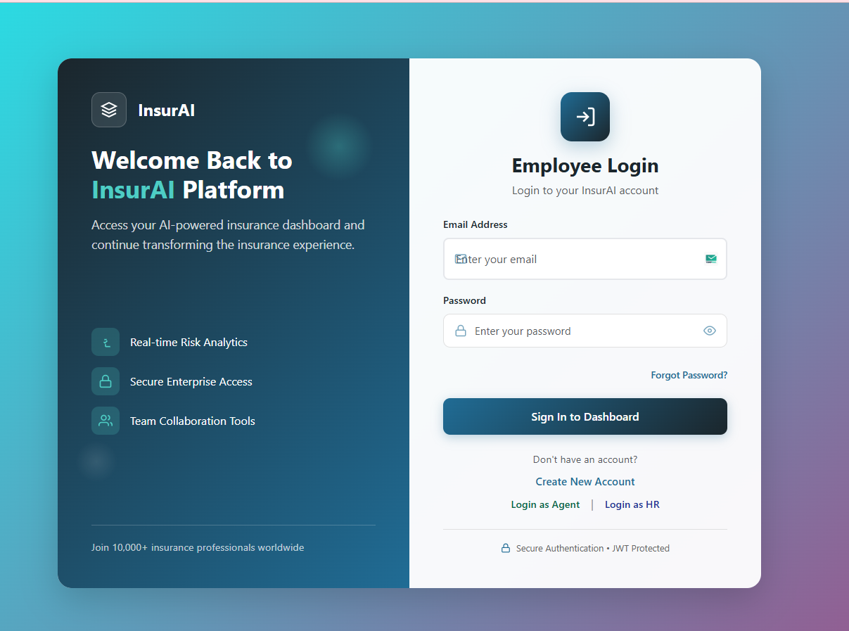
The Execution Flow: Phase 5 (Response & Navigation)
HTTP Response: The backend returns an HTTP 200 OK status code and a success message back to the React frontend.
State Update: The frontend receives the response; if successful, it store the user's session and once the user signs in, it returns a JWT token(useful for authorization of further employee functions).
Final Redirection: The React application navigates the user from the login page to the Employee Dashboard (/employee/dashboard).
9
Above shown is the picture of postman
console which shows the http response
from backend as we create the employee
while on frontend react redirects us to the
employee login page.

Slide 7
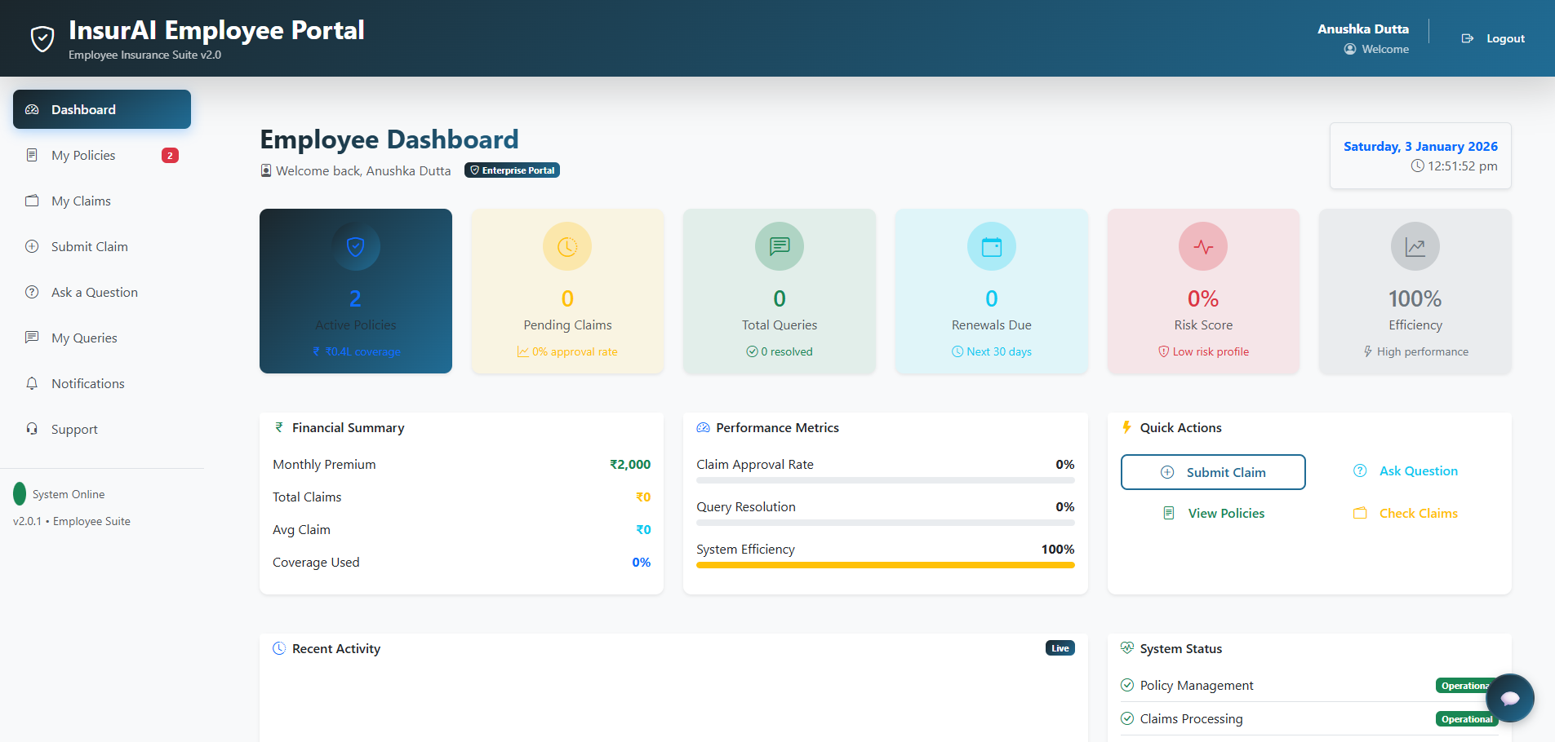
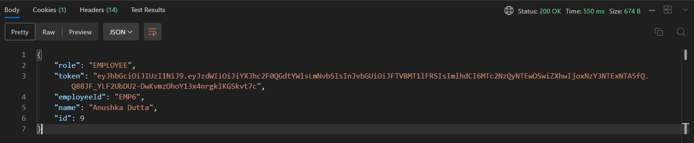
10
As soon as from frontend we click on log in after filling our credentials
we are redirected to the dashboard in frontend and at backend
SpringBoot provides the JWT token which is used for any
further claims or policies that employees do.

Slide 8
Optimizing User Access & Navigation
The Problem: "Hidden" Entry Points
Manual URL Entry: Previously, the system relied on users knowing specific endpoints (e.g., /agent/login or /hr/login).
High Cognitive Load: Employees, Agents, and HR staff had to memorize or bookmark different URLs, leading to confusion and support requests.
Security & Friction: Lack of a centralized "Entry Gate" made the system feel disconnected and increased the risk of users landing on unauthorized routes.
The Solution: Unified Gateway & Redirect Logic
Centralized Login Hub: Updated the main Employee Login page to act as the primary "Gateway" for all corporate personas.
One-Click Redirection: Integrated distinct, intuitive redirect links for Agent and HR roles directly on the main UI.
Improved UX Flow:
  User arrives at the standard login portal.
  User identifies their role via clear visual triggers (Links/Buttons).
  The system handles the route transition instantly, ensuring the user is on the correct authentication path.

Slide 9
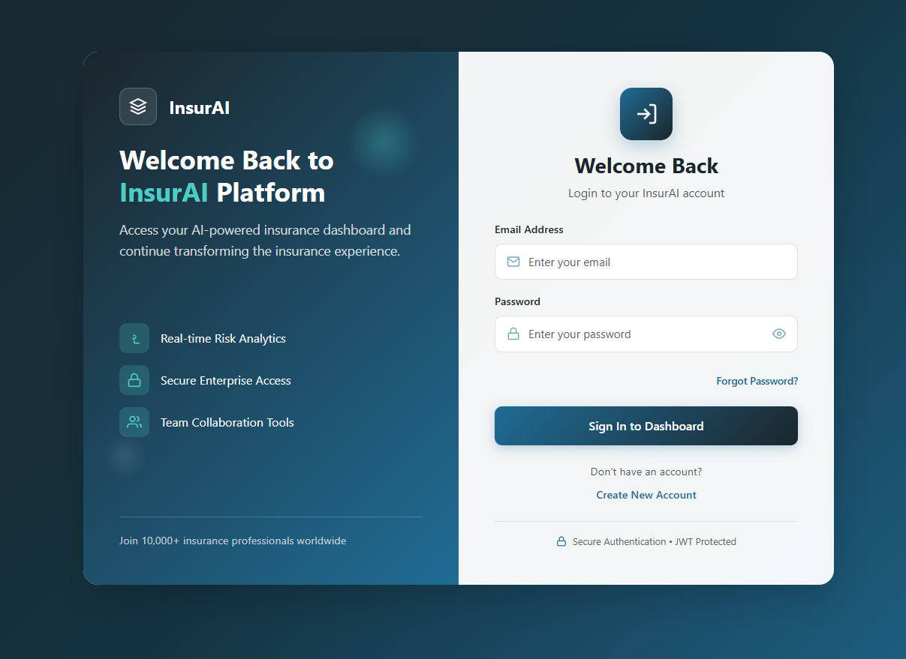
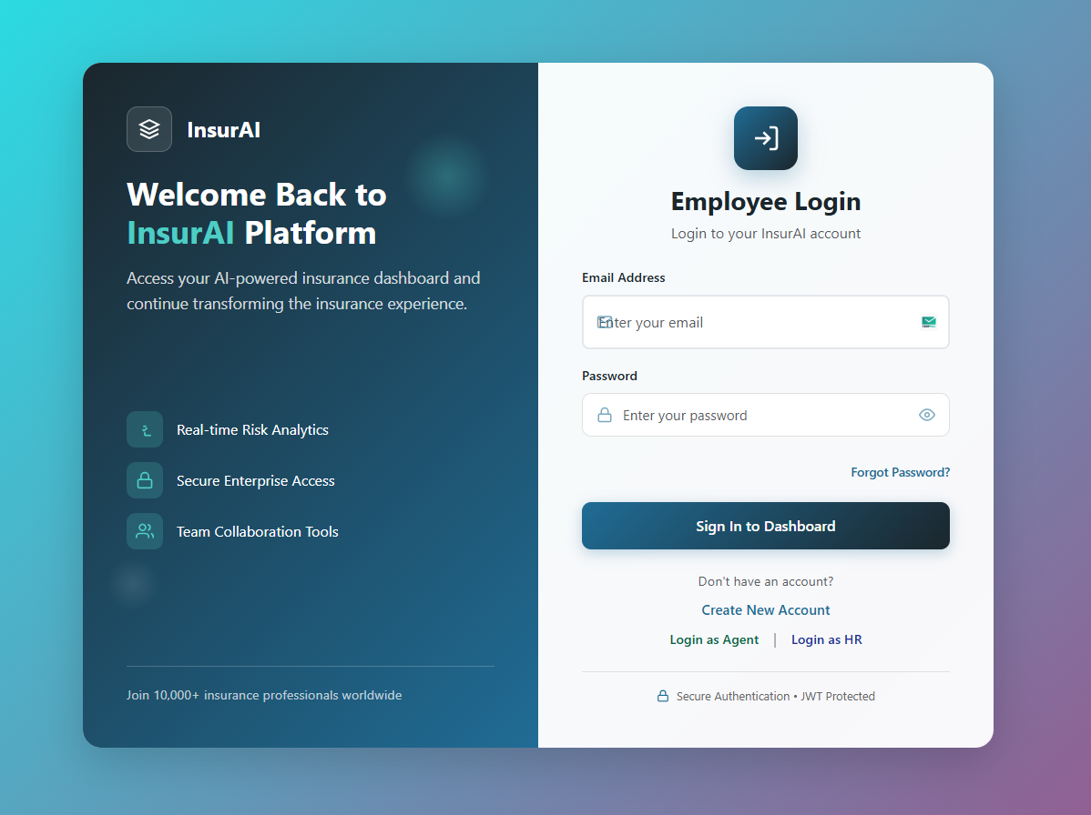
Impact & Benefits
Zero Memorization: Eliminated the need for staff to remember complex technical URLs.
Seamless Onboarding: New Agents and HR staff can navigate the system immediately without training on "where to go."
Professional UI: Transformed the login experience from a "technical interface" into a polished, corporate-grade application.

Slide 10
CONCLUSION
Backend Robustness
Core API Development: Successfully implemented the Spring Boot REST controllers and service layers to manage core "InsurAI" business logic.
Database Integration: Established a secure connection with Supabase (PostgreSQL), ensuring data persistence and integrity for all user roles.
Service Layer Logic: Built scalable service components (e.g., AgentService) to handle data processing independently from the UI.
2. UX & Navigation Optimization
Simplified Access: Resolved the "URL Memorization" issue by integrating direct redirect links for HR and Agent personas on the primary login page.
Role-Based Entry Points: Created a clear visual hierarchy that directs users to their specific authentication routes, reducing friction and entry errors.
Improved System Flow: The transition from the Frontend (React) to the Backend authentication filters is now seamless and user-friendly.

Slide 11
THANK YOU

